Slide 1

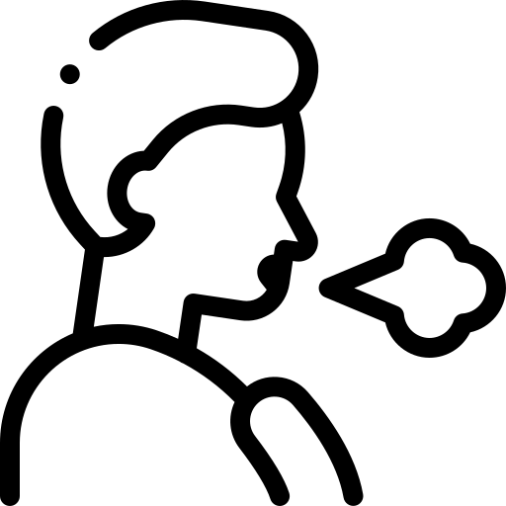
Breathing Rate from Video
Matthew Makila, Zahid Hasan, Azim Khan, Dr. Nirmalya Roy

Slide 2
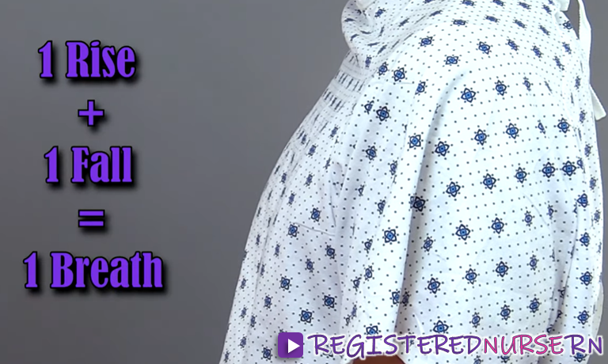

Problem Statement
Respiratory Rate: Number of breaths (respiration activities) for one minute.
Indicator of potential respiratory dysfunction, physiology of acutely-ill patients and early warning
Actions/Emotions (crying, sleeping, agitation, exercise, age) have large influence on respiratory rate.
Facilitate identification of changes in physiology along with other vital signs.
Physics: Some body-parts motion due to breathing
Our abdomen, shoulder, head moves with our breathing as the diaphragm moves.
Video contains Human breathing rate induced motion in its spatio-temporal frames
Idea and Task from VIDEO Signal
Issues with contact-based methods
Detect the corresponding body-parts
Track their movements from video

Slide 3
Problem Breakdown: Complexities vs. Simplicities
Noise
Talking, moving, types of clothing, facial expressions
Video issues
Complex backgrounds (other people or objects), misalignment of body within frames
Starting simple …
Manually define regions to measure Respiratory Rate (RR) from the chest, abdomen, and shoulder
The idea: observe how spatial signal changes over time to predict RR in clinical settings
Assumptions:
We can simplify the problem for now by reducing complexities and focusing on calculations
We test a person in several static positions for several minutes at a time
We do not have them talk
We keep the background for testing minimal

Slide 4
Challenges in Related Work
Lack of dataset and no variability in subject positions
There are few works that utilize large datasets with a diverse subject pool or variety of testing positions
Video processing computation
Previous methods utilize computationally-heavy ML networks to find RR
AHN, CNN, etc (take lots of training and resources)

Slide 5
Building a Dataset (Expectations)
We need sample breathing data
Build a holistic and representative dataset
We want to include data for varying circumstances that exist within our major limitations
Samples taken of different individuals from different backgrounds, genders, etc
Samples taken before and after eating
Samples taken before and after exercising
Some samples taken with known issues to outline boundaries & limitations

Slide 6
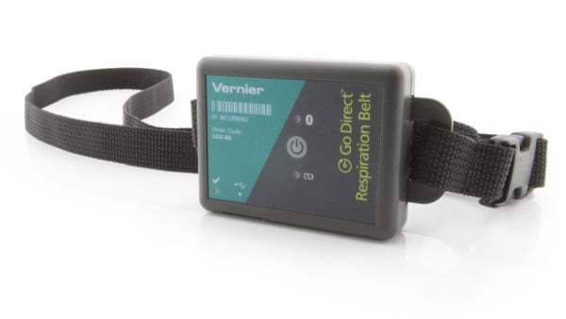
Data Collection
Details
3-5 min length
Volunteers are positioned either lying down or sitting (side and front profiles)
Front-facing camera of phone
Methods
(1) Setup ground truth (GT) measuring device
(2) Setup camera and tripod to fit body in frame
(3) Start video and then afterwards start GT device (on camera!)
(4) Record video entire video while subject remains still
(5) Disable GT device, then video
Fig. 1. Ground truth respiration monitoring device

Slide 7
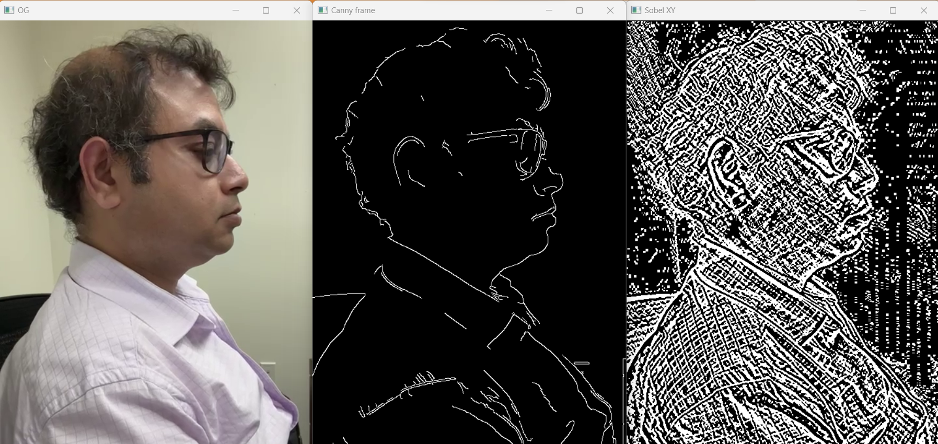
Methods (1)
Installed Anaconda + packages for Pytorch, OpenCV, and their related dependencies
Processing raw sample data provided into a video displaying different edge detection methods
The best: Canny edge detection
Fig. 2. Sample raw video processed with edge detection(s). From left to right, original video, Canny filter, and Sobel filter.

Slide 8
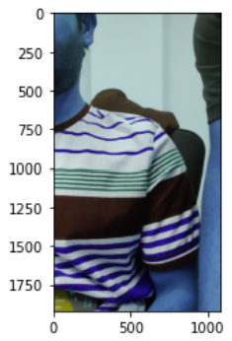
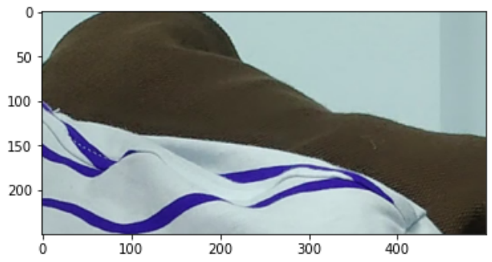
Methods (2)
Working with Anaconda + Spyder to analyze sample video data by extracting specific regions of interest (ROIs) from edge-detected frames to observe RR
Fig. 3. Manually selected ROI from raw video.
Fig. 4. Raw frame from sample video.

Slide 9
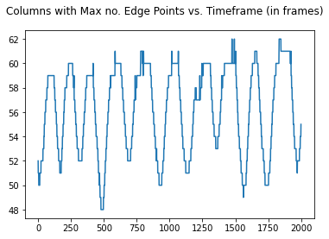
Methods (3): An Energy-based Approach
Row, column, and full sum techniques
We want to check how point concentration shifts within each frame
And where their highest concentrations are per row/col
Requires filtering in frequency domain
RR frequency is limited within a range (typically low)
Filter out the noise range
Low-pass filtering
Fig. 5. A sample video’s raw noisy signal plotted as the column numbers featuring the maximum number of edge points against the timeframe, specified by the number of frames

Slide 10
Methods (4): Cleaning Data
To better examine our video data, we can look into balancing different filtering
Low-pass
Extract low-frequency components of signal, emphasize slower and larger change but less sporadic noise
Designed Butterworth filter
FFT
Breaks apart various components of signals and helps identify patterns in temporal changes
Allows automatic choice between row, column, or full sum technique for samples

Slide 11
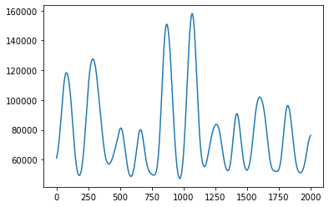
Data Analysis (Example)
Filtering + better ROI extraction has made for the production of cleaner + more meaningful data
A rough sketch of the subject movement shown in fig. 1.
A distinct pattern emerges with movement corroborated visually with video data (can eventually get us to the RR)
No. of points summed in frame
Timeframe (in frames)
Fig. 6. Plot of sample no. 20 using the full sum technique. The Butterworth low-pass filter was used to produce a clean plot.

Slide 12
Future Endeavors
Continuing to work in the lab
Polishing robust method for extracting RR
Proving its merit against the GT device and other metrics
Formulating the exact RR
Finding accuracy, errors, etc
Testing effect of camera distance
Creating an algorithm and/or incorporating ML for anomaly removals (talking and movement)
Some directions may include Viola-Jones algorithm
Shifting from recorded video to live testing
Working alongside Zahid to publish a report for SMART and CHASE conferences

Slide 13



Acquired Skills
Learning data filtering, signal processing uses/techniques, and python libraries to process and analyze data
Reading papers and deciphering important information

Slide 14
Research Experience
The Mantra: Measuring the BR of a living person without touching them is a difficult task
I have learned tons about the research environment, the importance of mentor relationships, and the tenacity research requires
In summary: it’s been falling down, getting up, falling again, … and getting back up again
It takes resilience to bounce back in the face of failure and adversity; that’s what discovering new ideas can feel like at times

Slide 15
Acknowledgements
NSF REU Grant
MPSC Lab & REU
Special thanks to Zahid Hasan for project support and Azim Khan for initial dataset

